Slide 1

Market Basket Analysis
Learn how data can uncover hidden links between products and help businesses better understand their customers.
- Nikhil Lanke

Slide 2

What is Market Basket Analysis (MBA)?
Market Basket Analysis is a powerful data mining technique that uncovers which products customers tend to purchase together. By examining transaction patterns, retailers gain actionable insights to optimise product placement, enhance cross-selling strategies, and design more effective promotions.

Slide 3
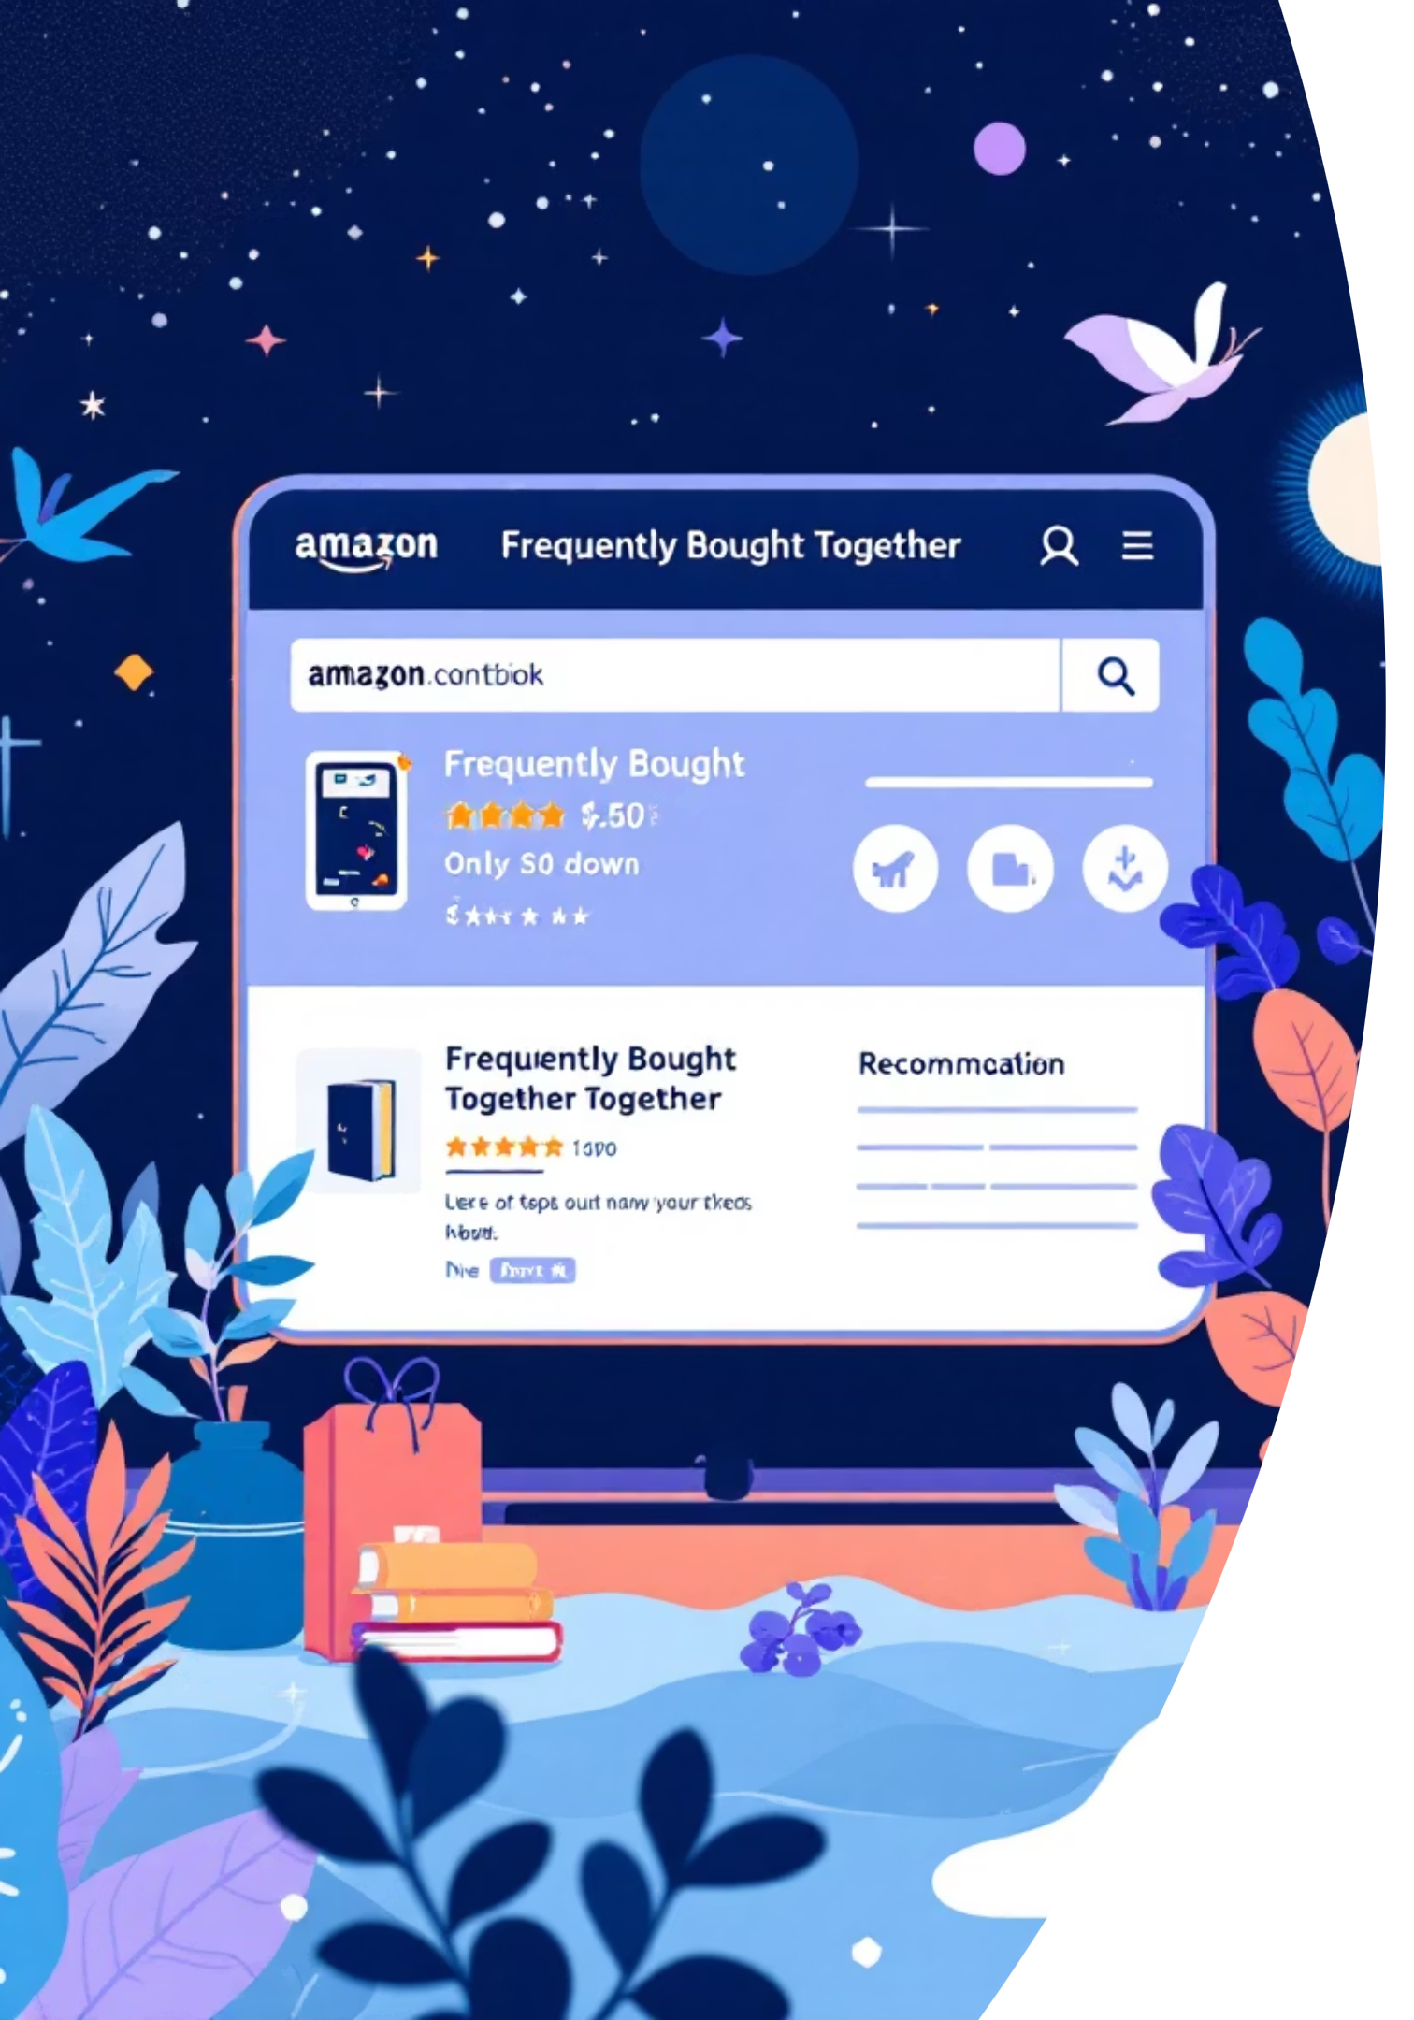






Why Does MBA Matter?
Purchase Patterns
Targeted Marketing
Customers buying bread often purchase butter and milk together, revealing natural product affinities
Enable precise marketing campaigns and better inventory management to boost revenue
Smart Recommendations
Powers Amazon's "Frequently Bought Together" and similar features across e-commerce platforms

Slide 4


Core Concepts: Association Rules
Association rules form the foundation of Market Basket Analysis, revealing meaningful relationships between products in customer transactions.
Antecedent
Consequent
IF green beans are bought
THEN french fried onions are likely purchased too
Support
Confidence
Lift
Measures how frequently items appear together in transactions
Indicates the likelihood of purchasing the consequent given the antecedent
Reveals the strength of association beyond random chance

Slide 5




The MBA Implementation Process
Data Preprocessing
Data Collection
Clean and transform raw data into a suitable format, handling missing values and creating transaction matrices
Gather comprehensive transaction data from point-of-sale systems, including product IDs, quantities, timestamps, and customer information
Implementation
Rule Evaluation
Translate insights into actionable business strategies, from store layouts to promotional campaigns
Apply algorithms to identify significant patterns and calculate support, confidence, and lift metrics

Slide 6

Real-World Applications Across Industries
Retail Optimisation
E-commerce Personalisation
Fraud Detection
Optimising store layouts and product bundling strategies, such as placing shampoo near conditioner to capitalise on natural purchase associations
Powering personalised recommendations and cross-selling on platforms like Amazon and Walmart, enhancing customer experience and driving revenue
Identifying unusual purchase combinations in finance and insurance sectors to spot potentially fraudulent transactions and protect customers

Slide 7

Challenges & Considerations
Data Requirements
Correlation vs Causation
Enhanced Context
MBA demands large volumes of clean, well-structured transaction data to produce accurate and actionable insights
Association rules reveal correlations between products but don't establish cause-and-effect relationships—interpretation requires business context
Incorporating additional data such as time of purchase, location, and customer identifiers significantly improves the depth and relevance of insights

Slide 8

Conclusion:
The highest lift value indicates the strongest association between products.
The most confident rules suggest which products are frequently bought together.
The output shows that "DOLLY GIRL CHILDRENS CUP" and "DOLLY GIRL CHILDRENS BOWL" have the highest association.
This insight can be used for:Product bundling - Placing frequently bought items together.
Cross-selling - Suggesting associated products during checkout.
Marketing strategies - Running promotions based on high confidence associations.

Slide 9
References:
For Data Sete:
https://www.kaggle.com/datasets/vijayuv/onlineretail
https://youtu.be/X5XwyOAanq0?si=hVeZl87aAVFrkP8M
https://drlee.io/introduction-to-market-basket-analysis-with-real-data-and-a-step-by-step-python-template-for-47b35d174e71

Slide 10
Thank You

